Slide 1
VITAMINS
Vitamin K
Vitamin E
Vitamin D
Presented by,
Mrs. STARINA FLOWER, M.Sc (N)
Assistant Professor,
Medical Surgical Department,
Annammal College Of Nursing, Kuzhithurai

Slide 2
VITAMIN K
Total 13 vitamins
Fat soluble vitamins..4
A,D,E,K
Vitamin k=antihemorrhagic factor

Slide 3
The reference range of vitamin K is 0.2-3.2 ng/mL, but impaired blood clotting has been associated with levels below 0.5 ng/mL

Slide 4
TYPES
VITAMIN K 1 FROM PLANT SOURCES
VITAMIN K2 FROM BACTERIA
VITAMIN K3 ,SYNTHETIC FORM

Slide 7
FOOD SOURCE
PLANT SOURCE
GREEN LEAFY VEGETABLES
CABBAGE,BROCCOLI,AVOCODO,BANANA,CAULIFLOWER
EDIBLE OILS
ANIMAL SOURCE
FISH LIVER,MEAT,EGGS,CERALS,MILK,FERMENTED FOOD SOURCES LIKE CHEESE

Slide 8
DEFICIENCY
HEMORRHAGIC DISEASE OF NEWBORN
IDIOPATHIC VITAMIN K DEFICIENCY BLEEDING
SECONDARY VITAMIN K DEFICIENCY BLEEDING
VITAMIN K DEPENDENT COAGULATION FACTOR DEFICIENCIES

Slide 9
CAUSES
INFANTS
ABSENCE OF GUT BACTERIA
LOWTRANSMISSION OF VITAMIN K ACROSS PLACENTA
VITAMIN K DEFICIENCY IN BREASTMILK
IN ADULTS
PARENCHYMAL LIVER DISEASE
MALABSORPTION SYNDROME
BILIARY DISEASE
DIETARY DEFICIENCY
DRUG INTAKE

Slide 10
Signs and symptoms
Issues related to problematic blood clotting or bleeding
Easily bruise or bleed.
Cartilage calcification.
Uncontrollable bleeding at surgical or puncture sites.
Brain bleeding in newborns

Slide 12
RDA
GROUP | AGE | INTAKE µG/DAY
INFANTS | 0 TO 12 MONTHS | 5 TO 10
CHILDREN | 1 TO 13 YRS | 30 TO 75
FEMALE | 14 AND ABOVE | 35 TO 55
MALES | 14 AND ABOVE | 35 TO 55

Slide 13
TREATMENT
At birth vitamin k
Oral vitamin k(5 to 20 mg)
Vitamin k1 im/sc
Monitor prothrombin level
In life-threatening bleeds, fresh frozen plasma (FFP) should be administered prior to vitamin K.

Slide 14
Vitamin K is available as phytomenadione (vitamin K) and as the synthetic water-soluble analogue menadiol sodium diphosphate.
Intravenous (IV) injections should be given slowly, as fast IV injection can cause bronchospasm and peripheral vascular collapse.
Intramuscular injections may lead to severe haematoma formation at the injection site if clotting is impaired.

Slide 15
VITAMIN E

Slide 16
The reference range of vitamin E in adults is 5.5-17 µg/mL.
In children, it is 3-18.4 µg/mL

Slide 17
FUNCTIONS
ANTIOXIDANT PROPERTY
FREE RADICAL SCAVENGER
ENZYMATIC ACTIVITIES
PROTECTS CELL MEMBRANE
AIDS IN MUSCLE GROWTH
IMMUNITY WARRIOR
GENE EXPRESSION
RBC PRODUCTION
ANTITHROMBOTIC

Slide 18
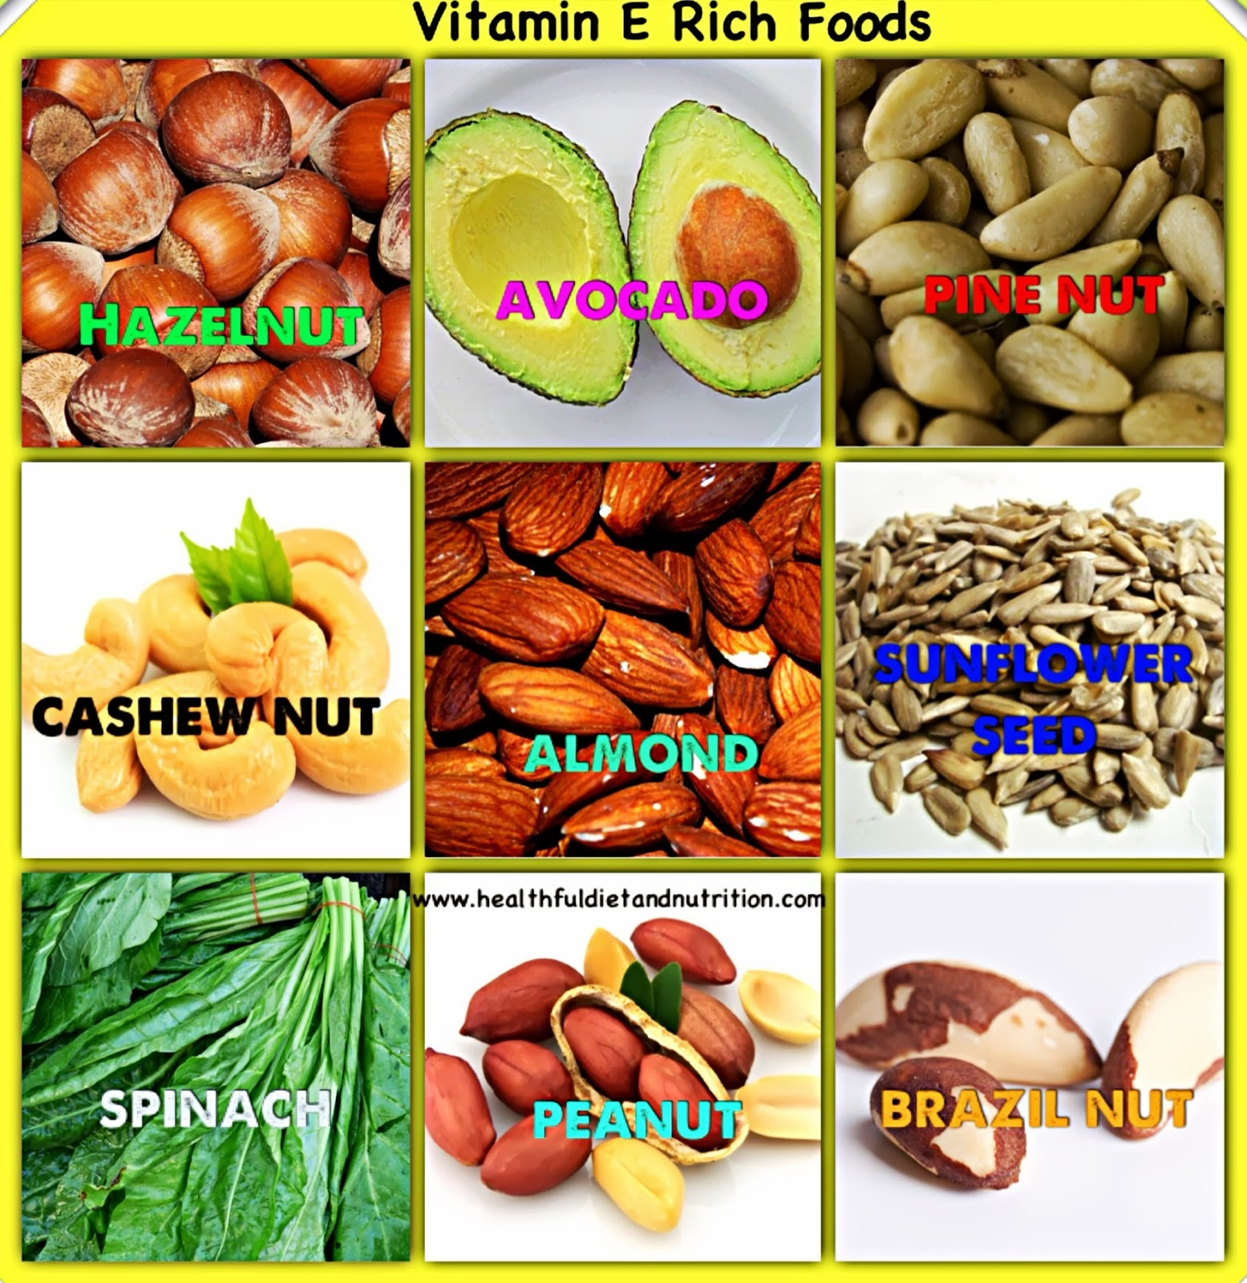

Slide 20
SOURCES
NUTS AND SEEDS(almonds, peanuts, dried apricots, seeds of sunflower)
VEGETABLES(spinach, broccoli, green olives, pumpkins, turnip greens, tomatoes)
FRUITS ( avocados, mangoes, kiwi)
VEGETABLE OILS (sunflower oil, corn, soya bean, safflower, wheat germ)
FORTIFIED FOODSTUFFS

Slide 21
CAUSES
DISEASE OF LIVER,GALLBLADDER,PANCREAS
PREMATURE MATURE BABIES
DEFICIENCY
HEMOLYTIC ANEMIA
RETINOPATHY
TOXICITY OF VITAMIN E

Slide 22
Vitamin E Deficiency Symptoms in Infants
Retrolental fibroplasia (an eye disease)
Loss of weight and delayed growth
Poor eating habits
Developmental problems that include physical and mental problem

Slide 23
Symptoms in Children
Gross lack of coordination of muscle movements with loss of deep tendon reflexes
Truncal and limb ataxia
Loss of vibration and position senses
Paralysis of extra-ocular muscles responsible for eye movements
Muscle weakness
Dysarthria (motor speech disorder)
Slow growth in children
Chronic liver disease, causing neurological deficits

Slide 24
Symptoms in Adults
Mild anemia
Nonspecific neurological deficits
Disorders related to reproduction and infertility
Fragile red blood cells
Age spots
Cataracts
Certain neurological damage
Decrease in sex drive
Muscle, liver, bone marrow abnormalities

Slide 25
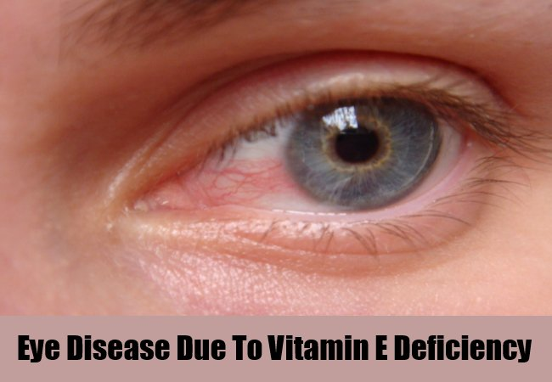
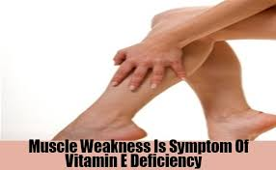

Slide 26
GROUP | AGE | INTAKE MG/DAY
INFANTS | 0 TO 12 MONTHS | 4 TO 5
CHILDREN | 1 TO 13 YRS | 6 TO 11
FEMALE | 14 AND ABOVE | 12
MALES | 14 AND ABOVE | 12
PREGNANCY |  | 15
LACTATION |  | 19

Slide 27
TREATMENT
Dietary supplements
α Tocopherol supplements
Human milk and commercial formulas have enough vitamin E for full-term neonates.

Slide 28
VITAMIN D

Slide 29
Level of 20 nanograms/milliliter to 50 ng/mL is considered adequate for healthy people.
A level less than 12 ng/mL indicates vitamin D deficiency.

Slide 30
Functions
PROMOTE INTESTINAL CALCIUM ABSORPTION
MAINTAIN ADEQUATE SERUM CALCIUM AND PHOSPHATE CONCENTRATION
MODULATES CELL GROWTH

Slide 32
sources
Fleshy of fatty fish
Fish liver oils
Egg yolks
Beef liver
Fortified products like cereals, dairy products, orange juice, yogurt
Basking in sun for 10 to 15 minutes

Slide 33
Types
D1
D2(ergocalciferol present in fortified food products
D3 (cholecalciferol present in sunlight and dietary sources)
D4
D5

Slide 34
DEFICIENCY
SERUM LEVEL FALL <20NG/ML
RICKETS
ABNORMAL SOFTENING OF SKULL,BONE TENDERNESS,MUSCLE WEAKNESS,BOWED LEGS
OSTEOMALACIA
MUSCLE WEAKNESS,WALKING DIFFICULTIES,DIFFUSE BONE AND JOINT PAIN,DIMINSHED STATURE

Slide 35
TOXICITY
SERUM LEVEL >150NG/ML
VOMITING,NAUSEA
EXCESSIVE THIRST AND URINATION
HIGH BLOOD PRESSURE
INVOLUNTARY MUSCLE CONTRACTIONS
WEAKNESS AND ORAL DEFECTS

Slide 36
GROUP | AGE | INTAKE IU/DAY
INFANTS | 0 TO 12 MONTHS | 400 T0 1000
CHILDREN | 1 TO 3 YRS | 2,500
CHILDREN | 4 TO 8 | 3,000
 | 9 AND ABOVE | 4,000

Slide 37
FORTIFIED MILK
VITAMIN D SUPPLEMENTS
SUPPLEMENTATION WITH VITAMIN D3-DAILY DOSE OF 800 TO 2,000 IU

